Slide 1
E-Commerce Site Customer’s Report
Data Innovators Challenge
Analyzed Data and Insights

Slide 2
Contents of this report
Introduction | Team, team members, tools used in this report, overview of entire raw data
Insights and Visualization | Presentation of insights, major findings with interactive dashboard
Conclusion | All the major findings and improvement suggestions

Slide 3

Team: Data_Divers_IIUC
Team Leader | S. M. Shahidullah Kaiser Talib Computer and Communication Engineering, IIUC
Member | Anjila Jerin Niha Computer Science and Engineering, IIUC

Slide 4
Introduction
Here we are given about 10000 curtomers data of a E-Commerce platform as records. Filtering, Cleaning, Data Processing, Data Analyzing are done here. We used only Microsoft Excel to accomplish this project.

Slide 5
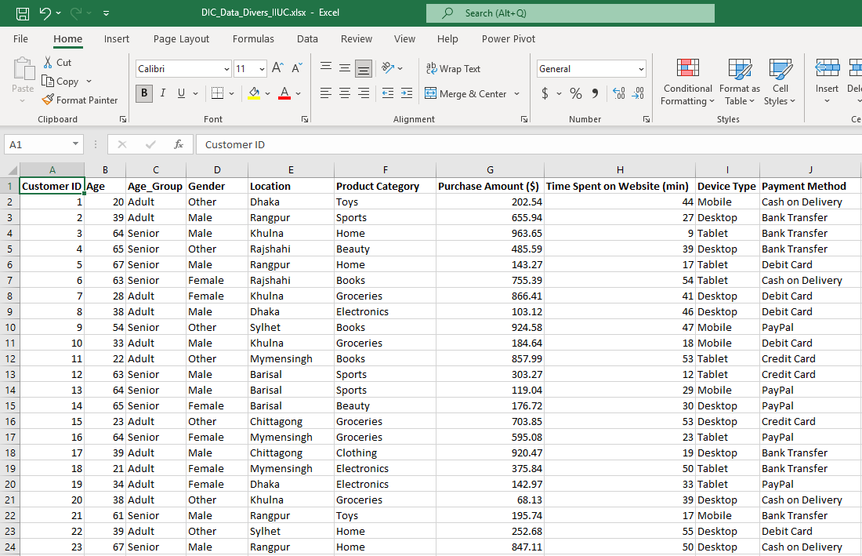
There residing 16 fields of data such as Customer ID, Location, Payment method, Purchase Amount and so on. For more Analysis, I added “Age_Group” field here
Figure: Little part of raw data

Slide 6



What have we done?
Data Cleaning
Data Processing
Data Analyzing
Data Visualization
Critical thinking

Slide 7
Customer Classification: Gender and Age

Slide 8
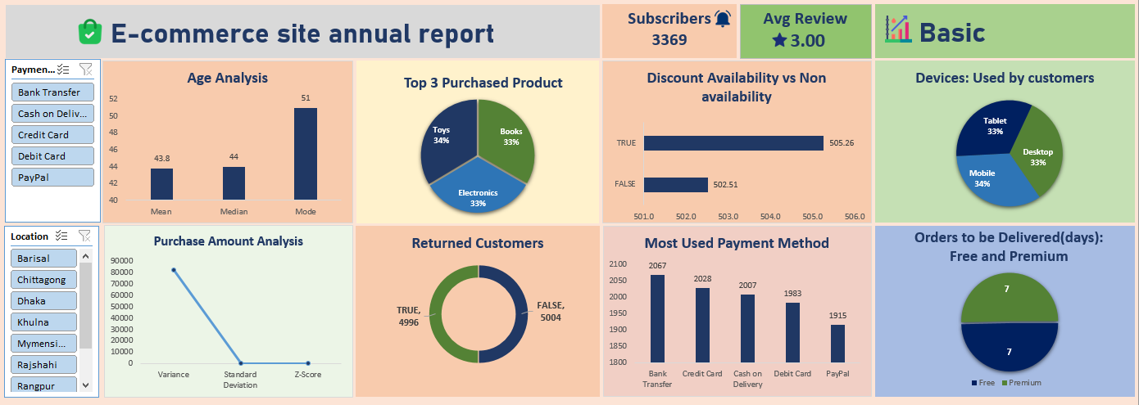
Dashboard: Insights

Slide 9
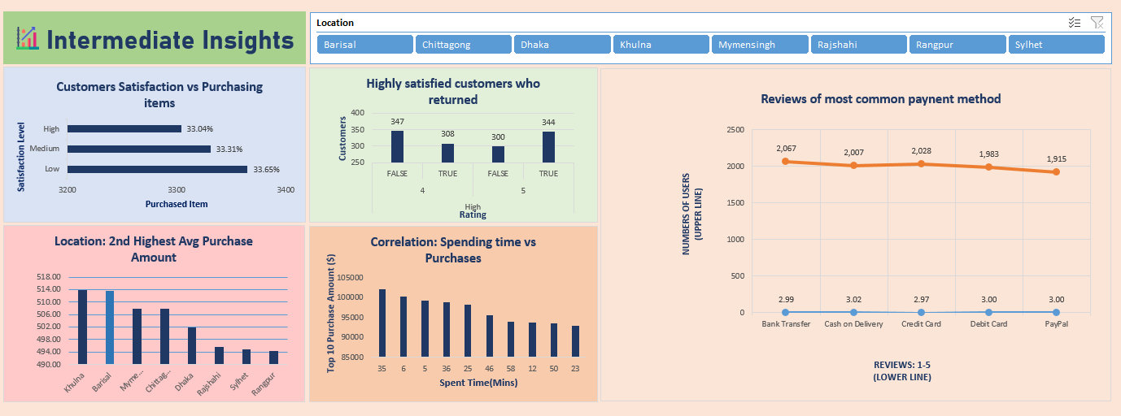
Continue…

Slide 10
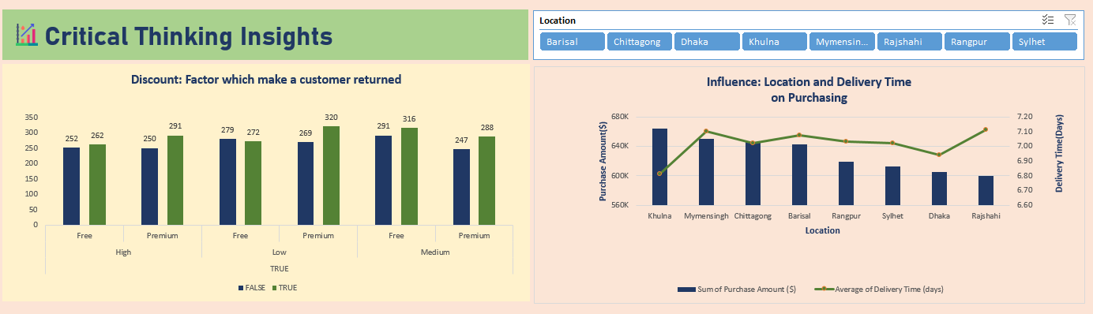
Continue…

Slide 11


Major Findings and Suggestions
Customer Satisfaction – Average
Review score (Avg – 3.00)
Addition of Easier Payment Method Suggested

Slide 12

Conclusion
Increment of service quality required
Faster delivery for Premium User
Addition of exciting offer

Slide 13
Thanks!
Presented by
Data_Divers_IIUC

